Slide 1
International study centre
An Introduction to computer binary execution

Slide 2
Name : Taha Al-Jody
Email: taha.al-jody@hud.ac.uk
Office: HA2/13 (High-Performance Computing Office)

Slide 3
Module Specification
Subjects to teach per week.
Assessments details.
Logbook per week required with marking rubric.
In class tests including practical and theoretical.
Available in office for student support.
In class exercises.

Slide 4
Plan
Binary Numbers & Introduction to C++ (Operators)
Array & Strings
Decision Making, loops
Functions, Classes and Objects
In Class Test , Logbook Submission , Hand-out the Final Project
C++ File Handling
Support Sessions for the Project
Project presentation, Project report submission

Slide 5
Binary Codes
Example:
Convert 10101 from Binary to Decimal.
What is Binary?
Number system.
Uses only two digits ( 0 and 1 ).
1 0 1 0 1
Solution:
Only consider binary bits when it is 1
How does it work?
Each position of a binary number represent a power of X to the base of 2.
2⁰ = 1
2² = 4
2¹⁶ = 16
Sum
1 + 4 + 16 = 21
Binary
Decimal
10101 = 21

Slide 6
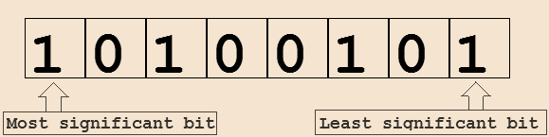
Binary Codes
Most Significant Bit (MSB):
It is the left-most bit in a binary code.
Least Significant Bit (LSB):
It is the right-most bit in a binary code.

Slide 7
Code to Program

Slide 8


Binary code execution
How does binary code gets executed in a computer architecture
1. OS Creates entry in process table.
2. OS Creates Virtual memory space.
3. Load binary code into memory.
Operating System (OS)
4. Points the process instruction pointer to the process entry point.
5. creates an entry in the scheduler and starts the execution.

Slide 9
Binary code execution
(2)
CPU Interaction with the code
Before a process is sent to the CPU
OS Register a timer.
As timer finishes:
CPU Register an interrupt.
CPU stores its state onto the memory.
Pushes Instruction pointer to the stack and jumps to the interrupt handler.
Central Processing Unit
The CPU Restore its state from the memory.
The CPU Continues execution.

Slide 10
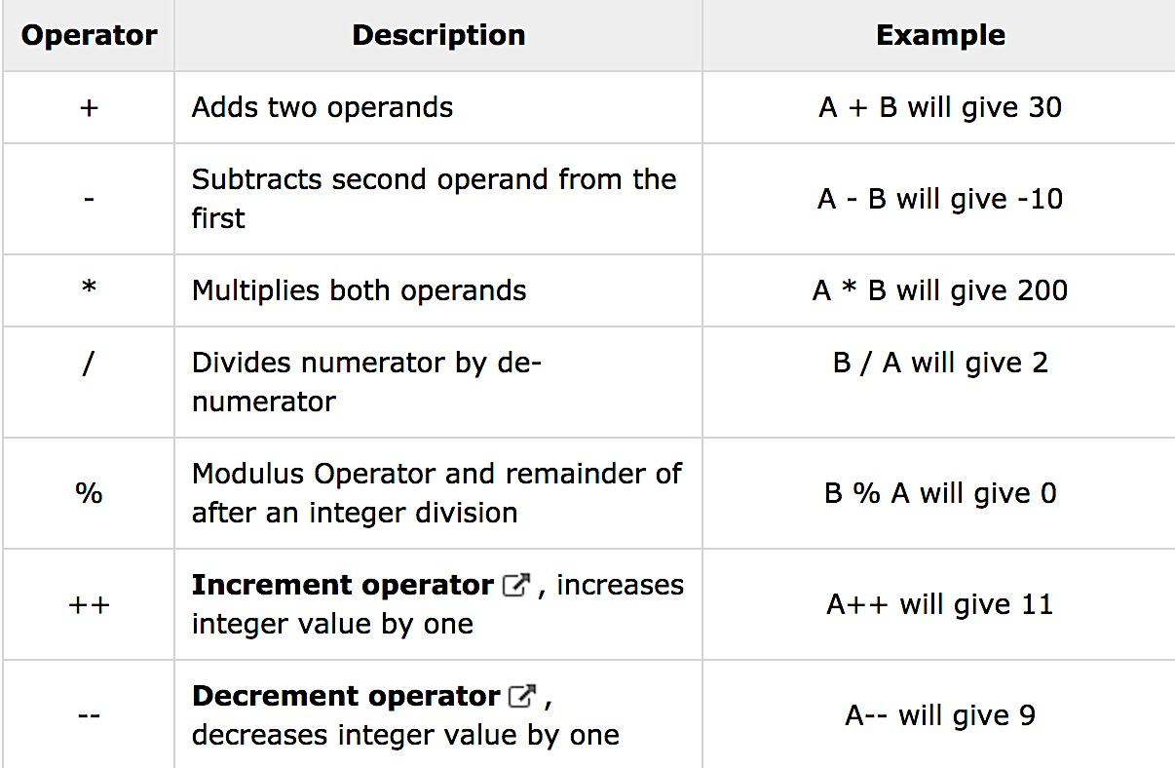
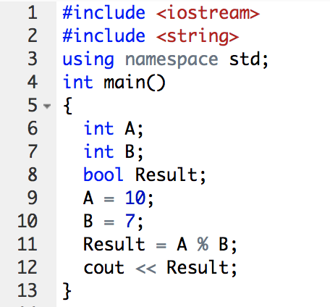
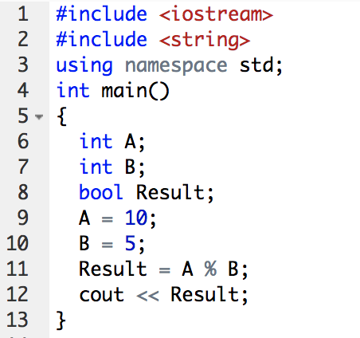
C++: Operators
Assume variable A holds 10 and variable B holds 20, then
1
0

Slide 11
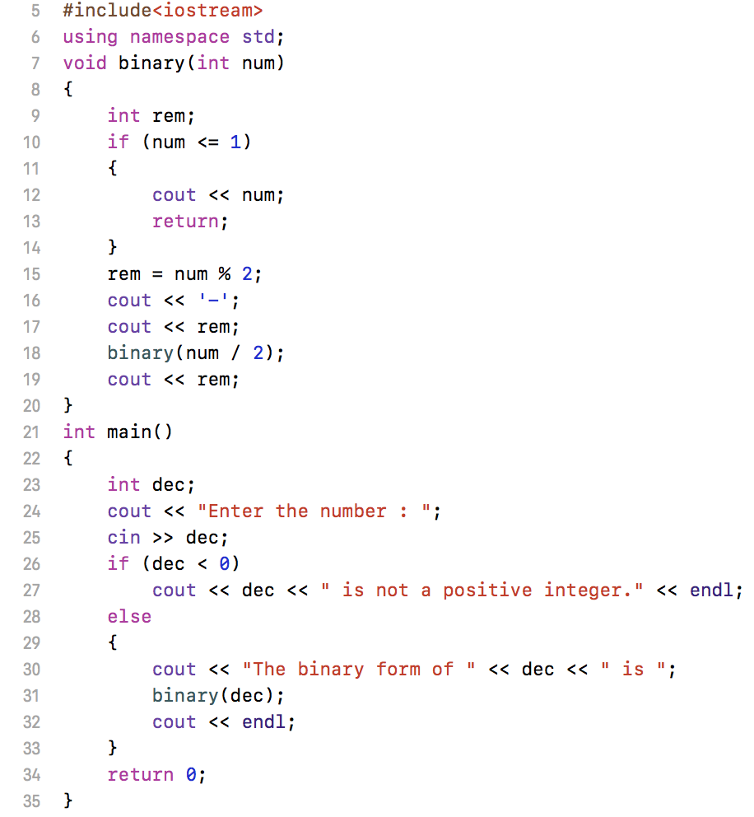

Software Code C++
C++ Code
Decimal to Binary Converter
How does it work?
Uses only remainder and division.
% in programming gives either 1 (if there is a remainder) or 0 (if there is no remainder).
Example: Convert 21 to Binary
21 % 2 = 1 (LSB) 21/2 = 10 (integer)
10 % 2 = 0 10/2 = 5
5 % 2 = 1 5 / 2 = 2
2 % 2 = 0 2 / 2 = 1
1 % 2 = 1 (MSB) 1 / 2 = 0
Output
21 = (MSB) 10101 (LSB)

Slide 12
Any Questions ?

